Slide 1
Streaming Data Processing
Rohan Chaudhari
Vishal Jha

Slide 2
Agenda
Project Statement
Project Overview
Project Requirements
Architecture Diagram
Implementation
Conclusion

Slide 3
Project Statement
Set up an end-to-end pipeline with Azure Data Factory for ingesting streaming data and Azure Databricks for real-time processing and analysis of the streaming data.

Slide 4
Project Overview
The primary goal of this project is to design and implement a end-to-end data pipeline using Azure Data Factory (ADF) and Azure Databricks to ingest, process, and analyse streaming data in real-time. The pipeline will enable the extraction of valuable insights from the streaming data source, providing a foundation for timely decision-making.

Slide 5
Project Requirements
Azure Subscription
Data Source
Azure Event Hub
Azure Stream Analytics
Azure Data Lake
Azure Data Factory
Azure Databricks

Slide 6
Azure Subscription
You’re required to have an Azure Subscription to perform this project

Slide 7
Data Source
Created a python application, which fetches the weather data from the google website

Slide 8
Azure Event Hub
Azure Event Hubs is a cloud-based messaging service provided by Microsoft Azure which enables large-scale, real-time event streaming for ingesting and processing data from various sources

Slide 9
Azure Stream Analytics
Azure Stream Analytics is a cloud-based service provided by Microsoft Azure that helps you analyse and gain insights from real-time data streams

Slide 10
Azure Data Lake
Azure Data Lake is like a massive storage space in the cloud where you can store and manage enormous amounts of data. It's designed to handle both large files and lots of small files

Slide 11
Azure Data Factory
Azure Data Factory is like a digital factory that helps you collect, transform, and move your data from one place to another in a smooth and organized way

Slide 12
Azure Databricks
Azure Databricks is like a super-smart workspace in the cloud where you can easily analyse and process large amounts of data using the power of Apache Spark.

Slide 13
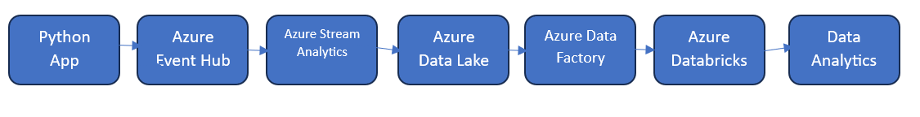
Architecture Diagram

Slide 14
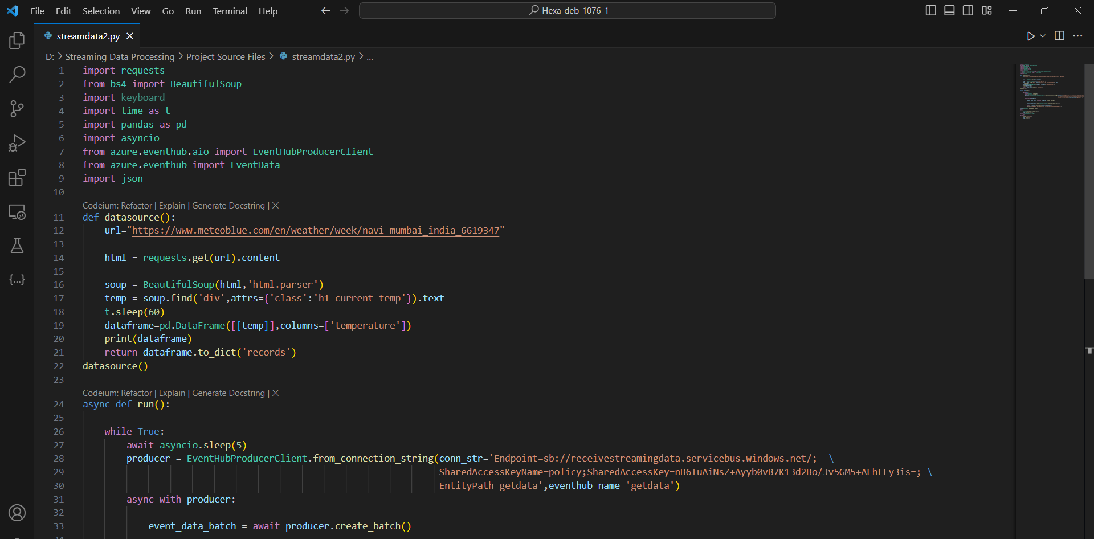
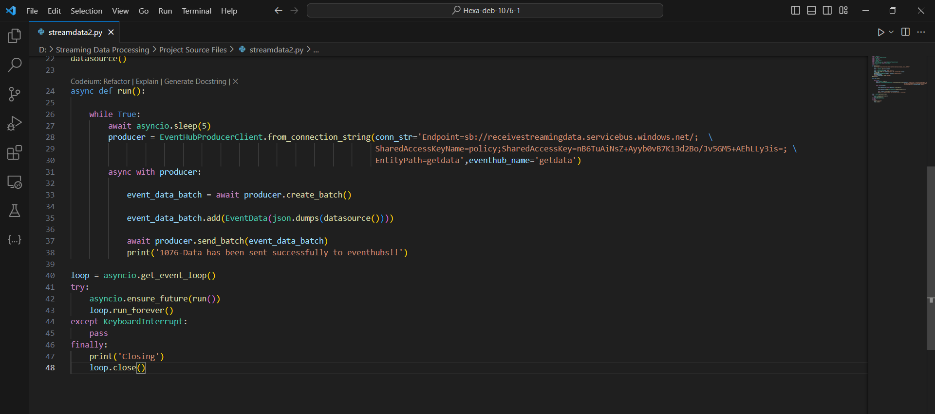
Implementation
Python Application
Creating Python Application

Slide 15
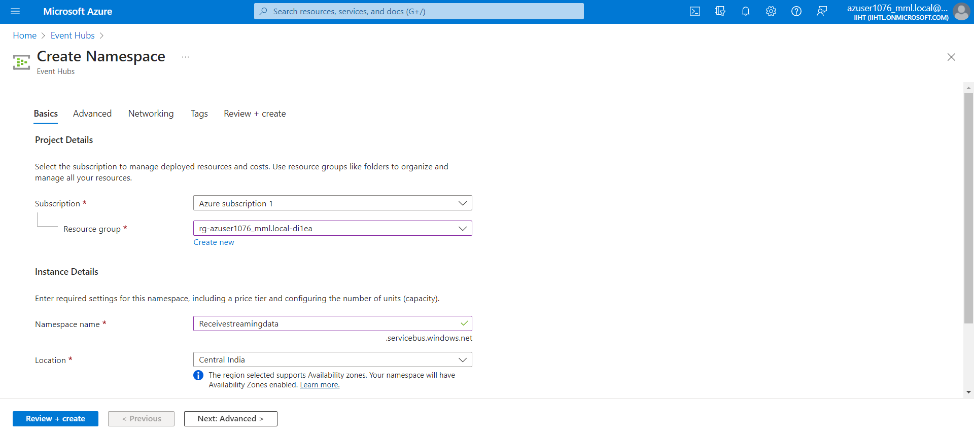
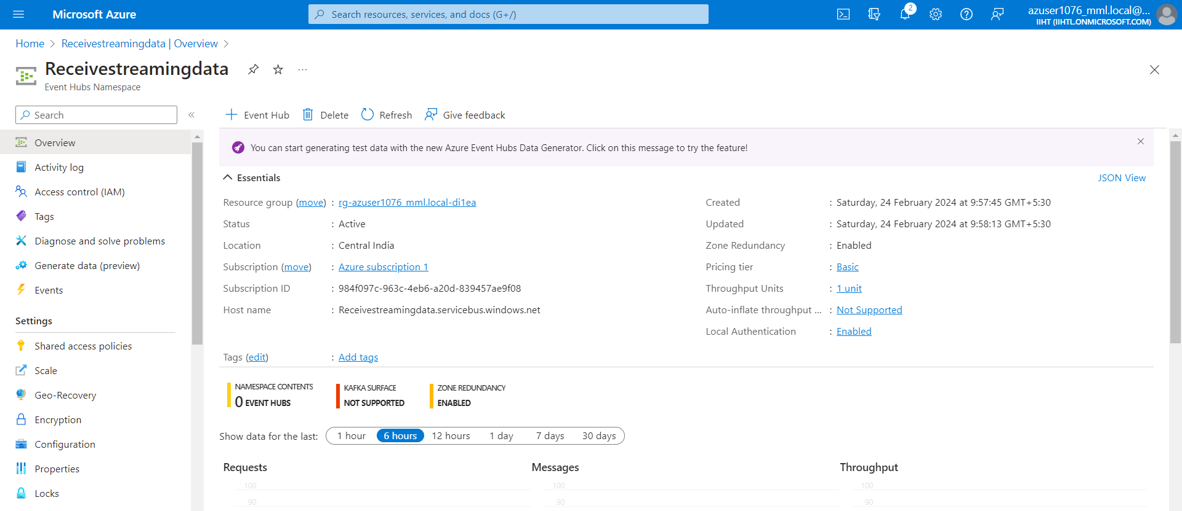
Event Hub Operations

Slide 16
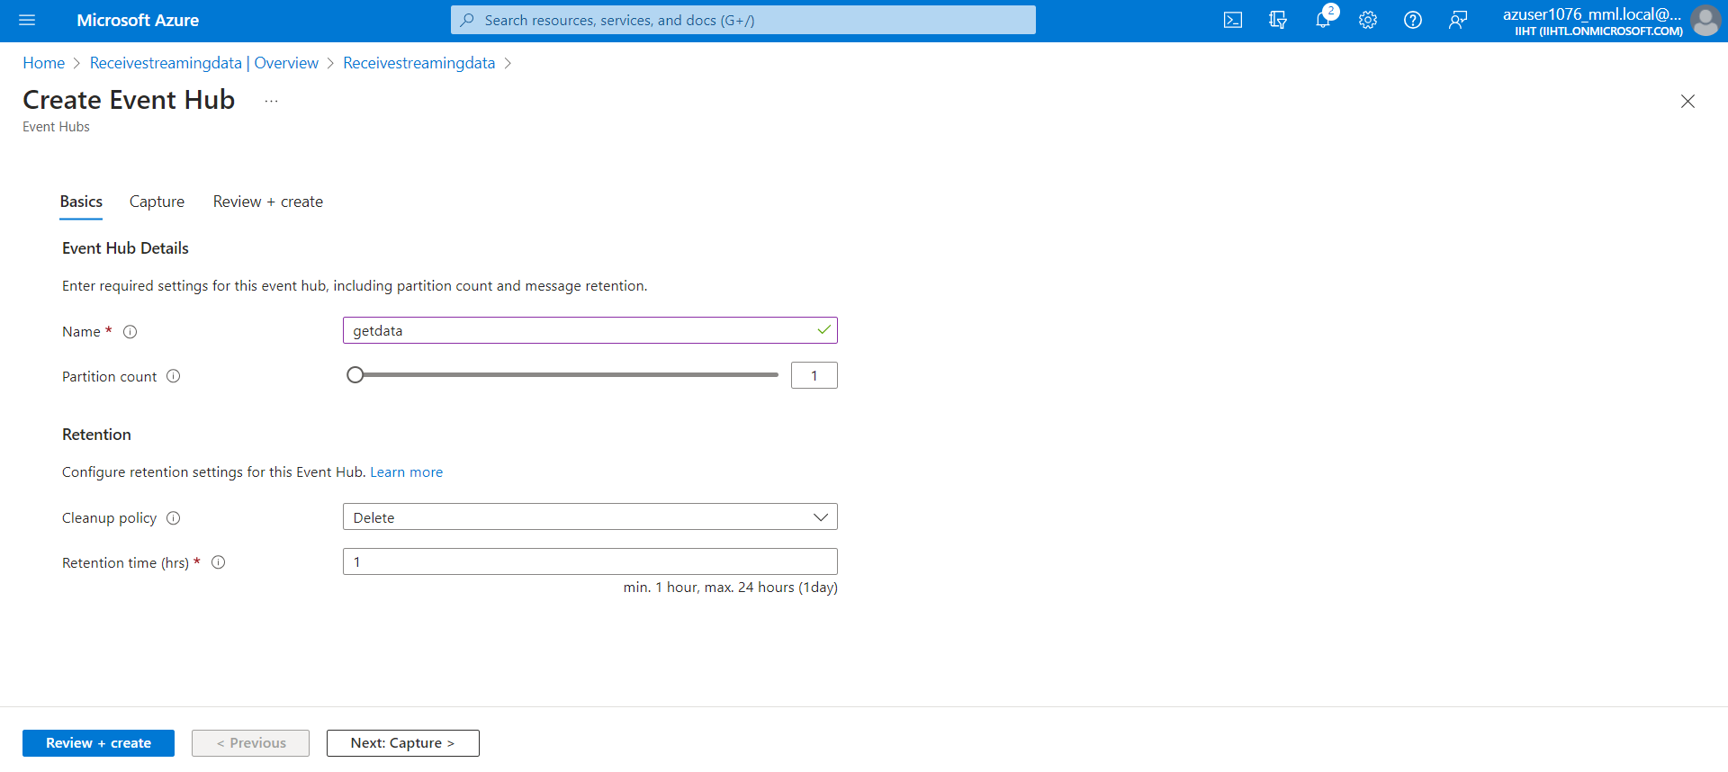
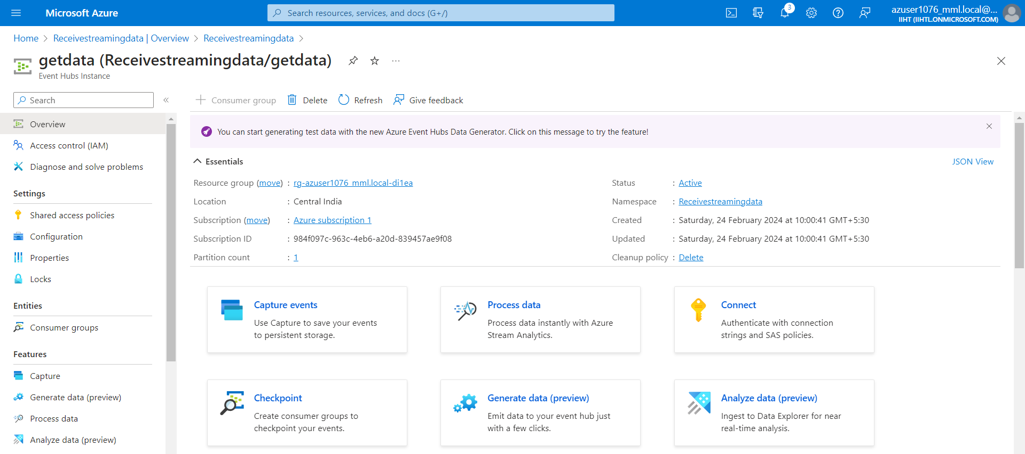
Creating Event Hub
Output

Slide 17
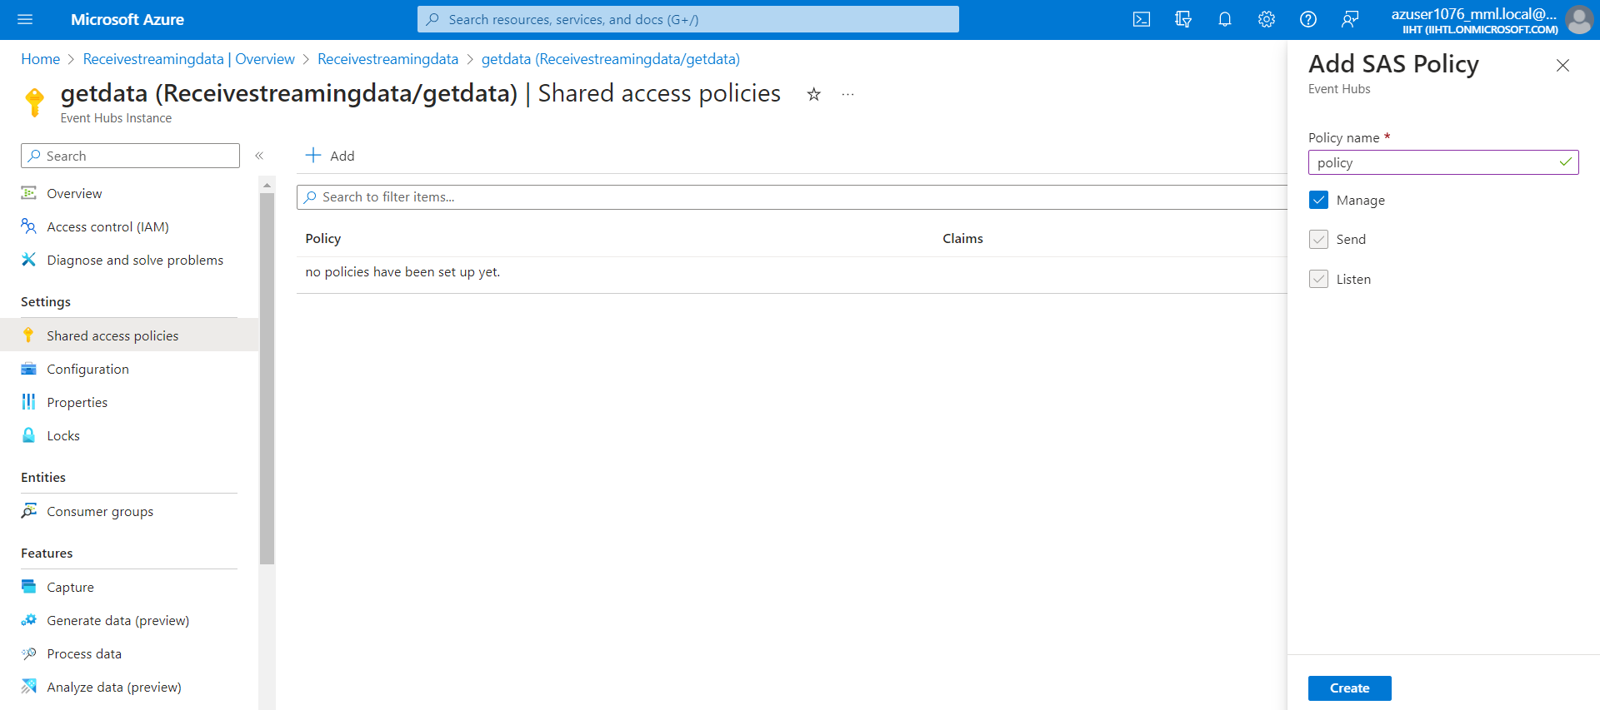
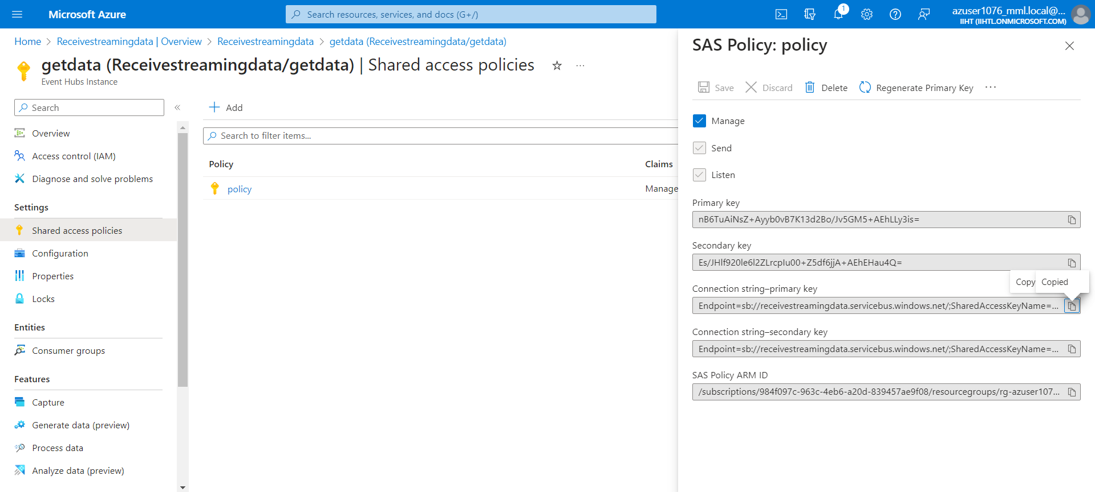
Creating a Policy
After creating the policy, copy the connection string primary-key and paste that in the python application to establish the connection

Slide 18
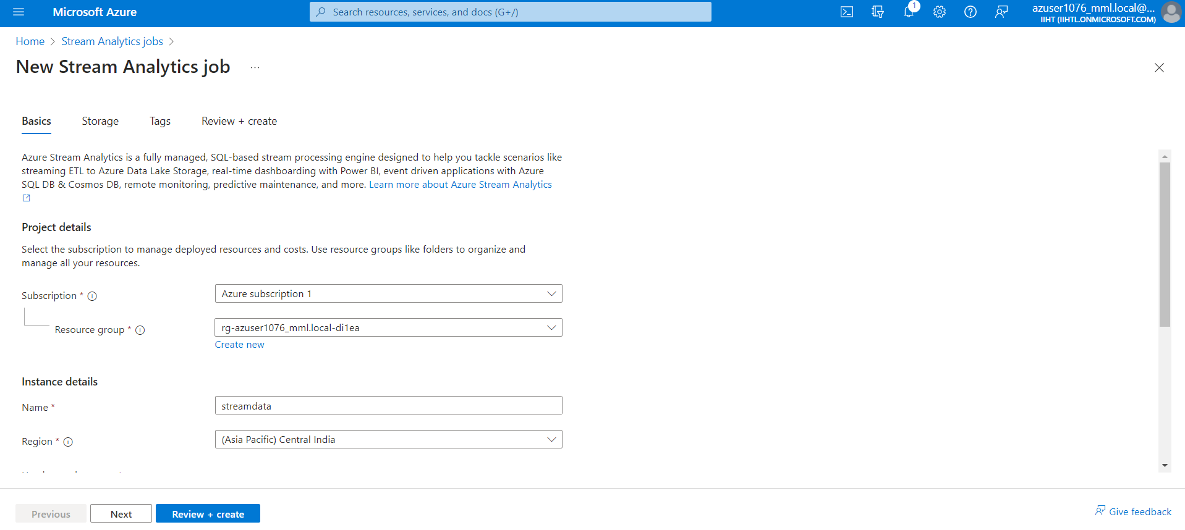
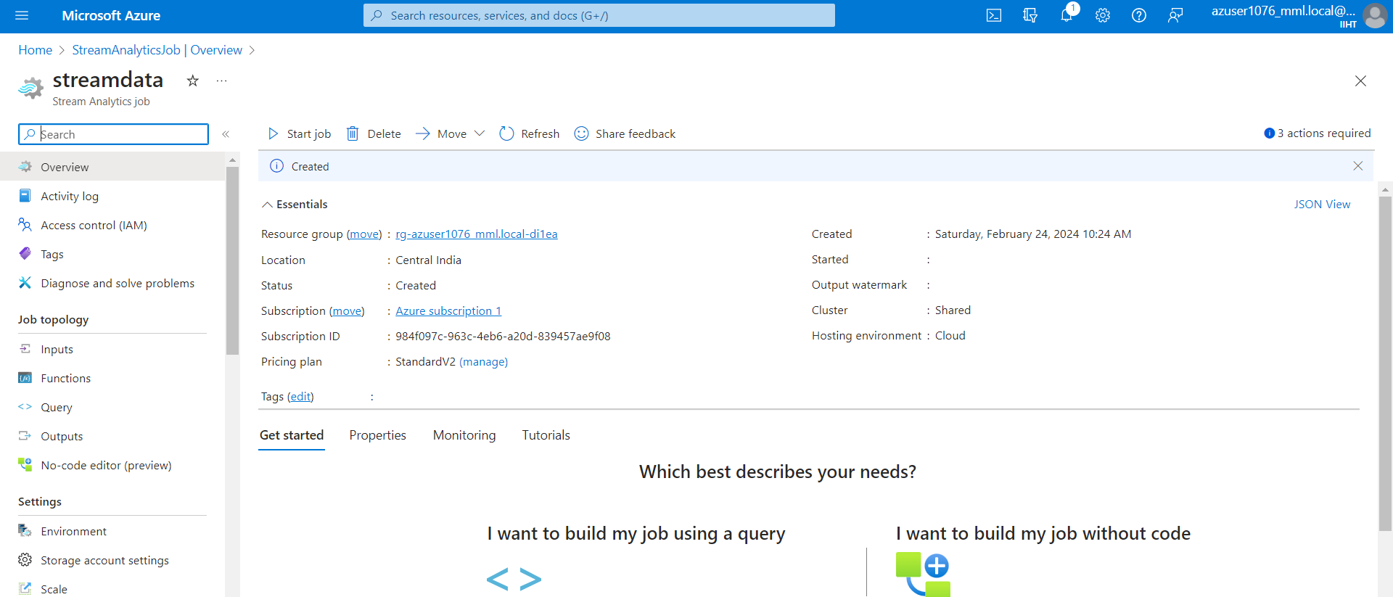
Azure Stream Analytics Job
Creating an Azure Stream Analytics Job
Output :

Slide 19
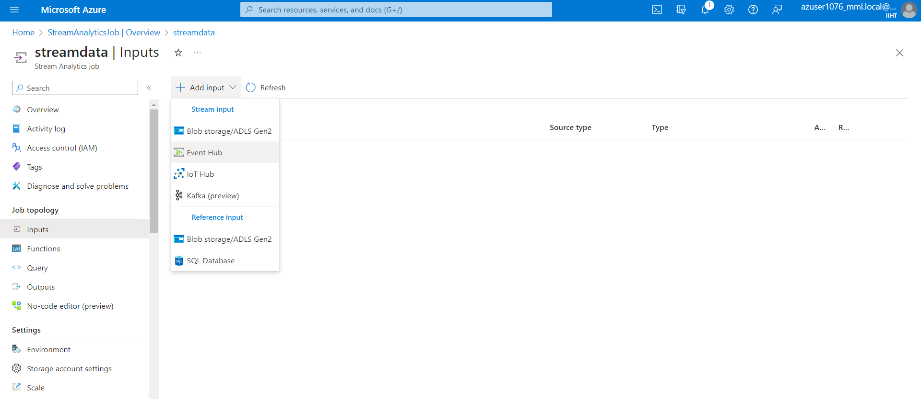
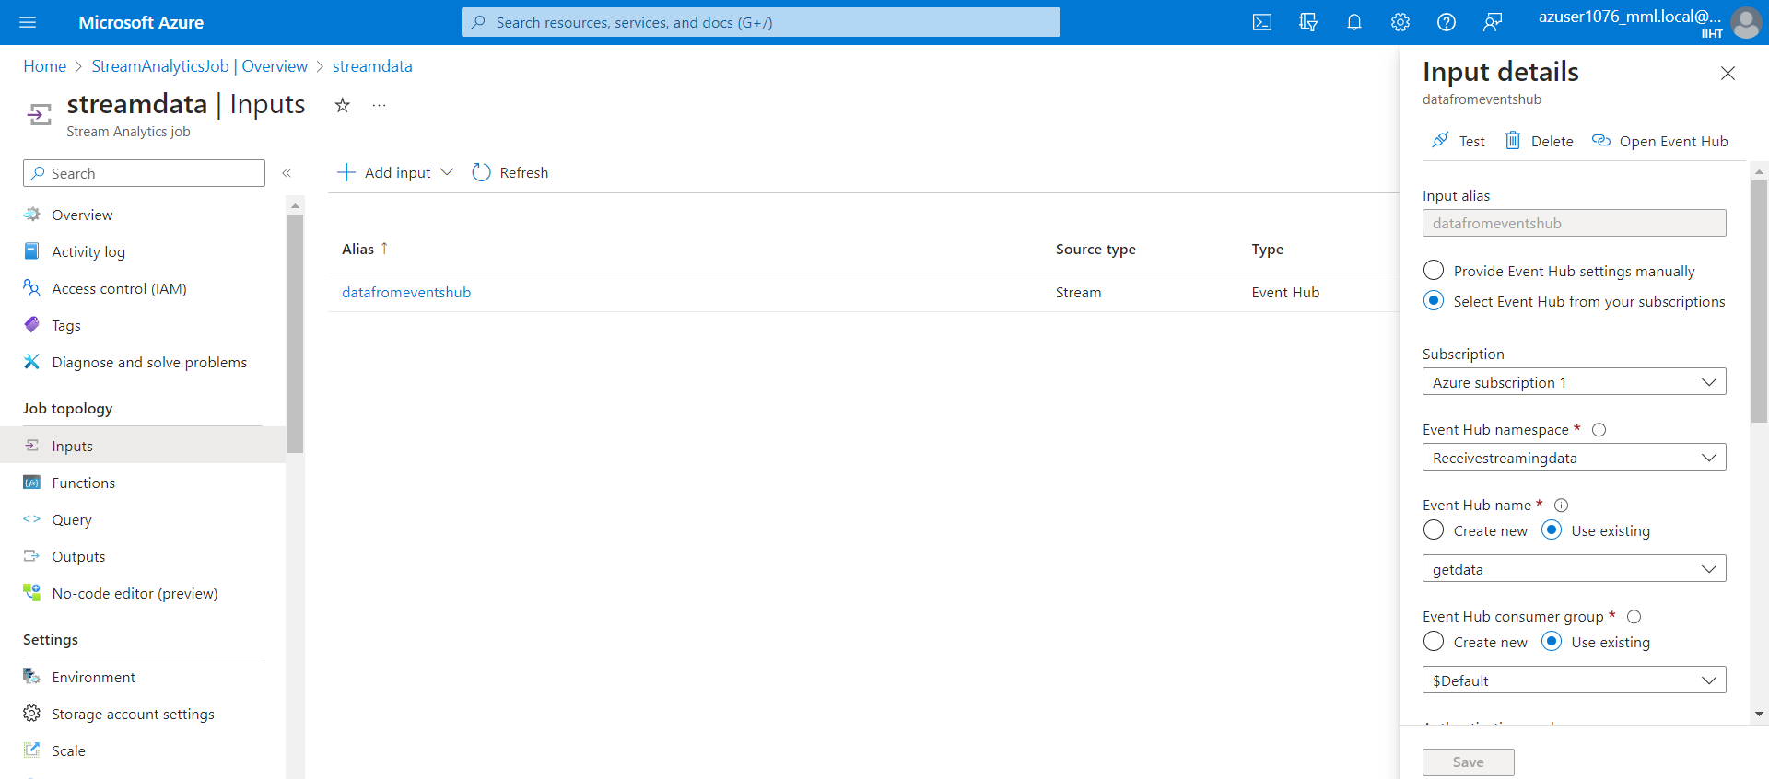
Adding Input to the Azure Stream Analytics Job
Enter the Event Hub Namespace name and other details in the input field

Slide 20
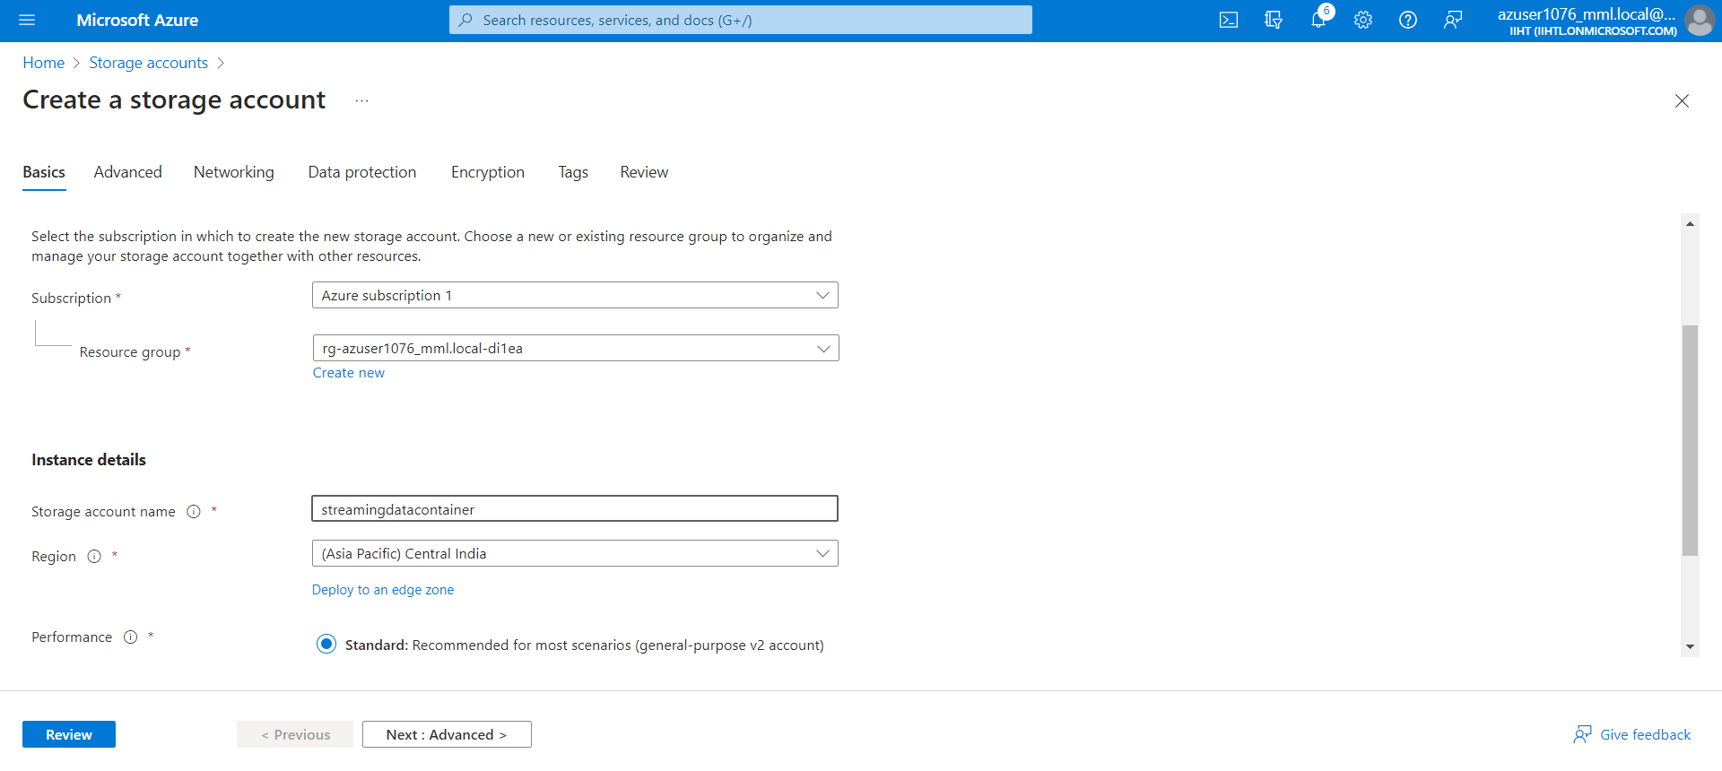
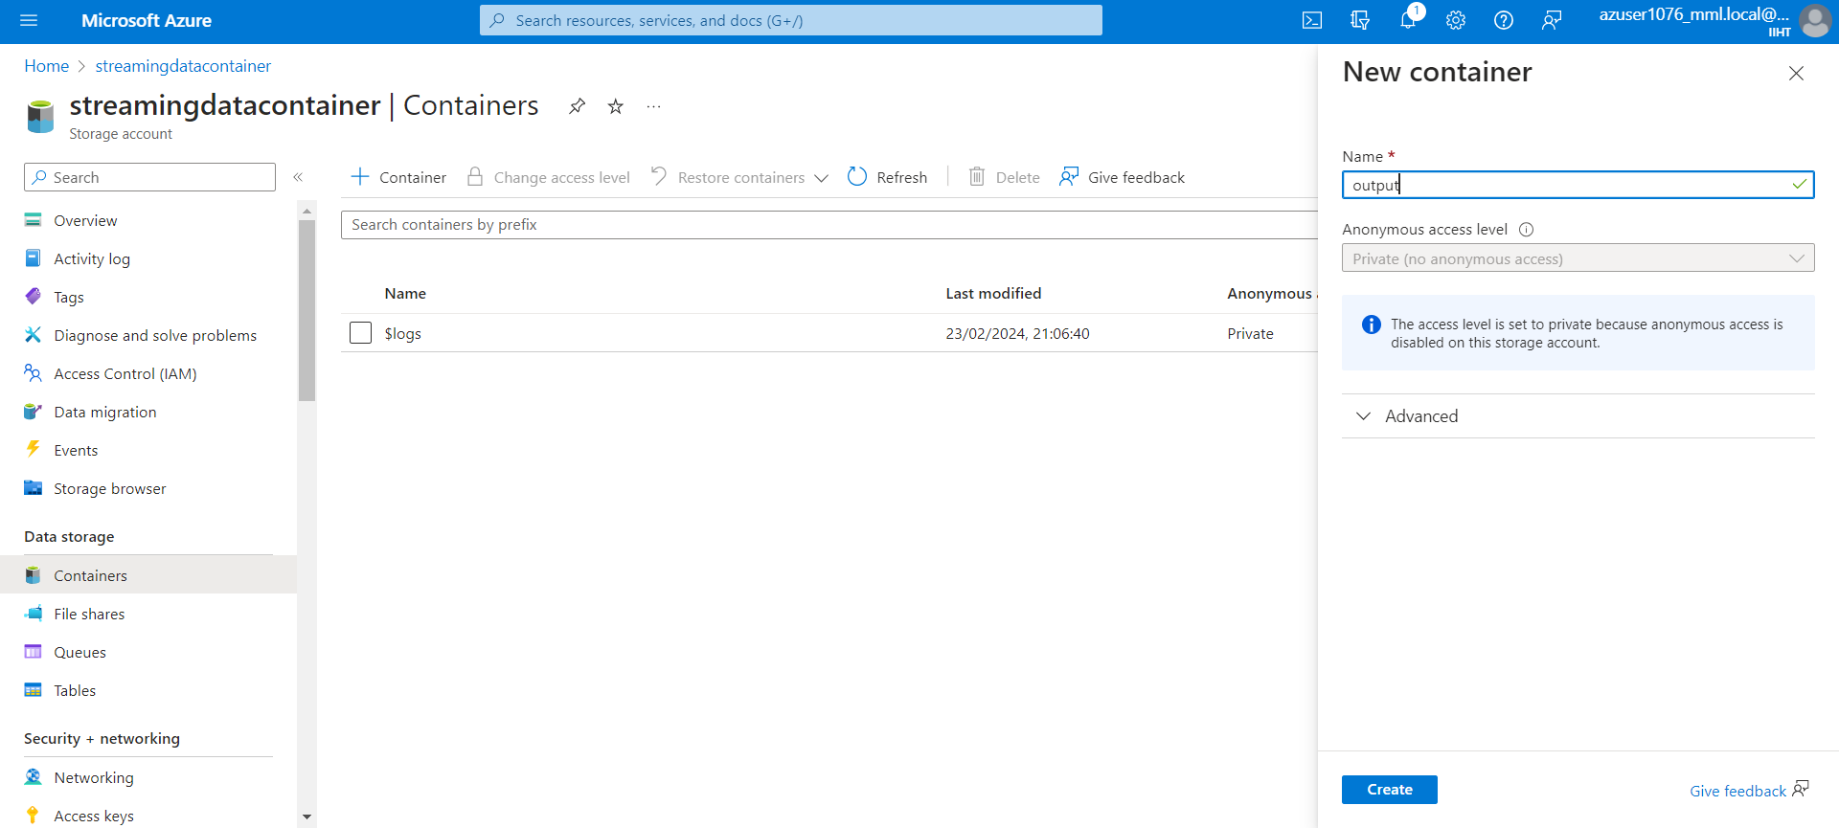
Storage Account Creation
Creating an Azure Data Lake Storage Account
Creating a container

Slide 21
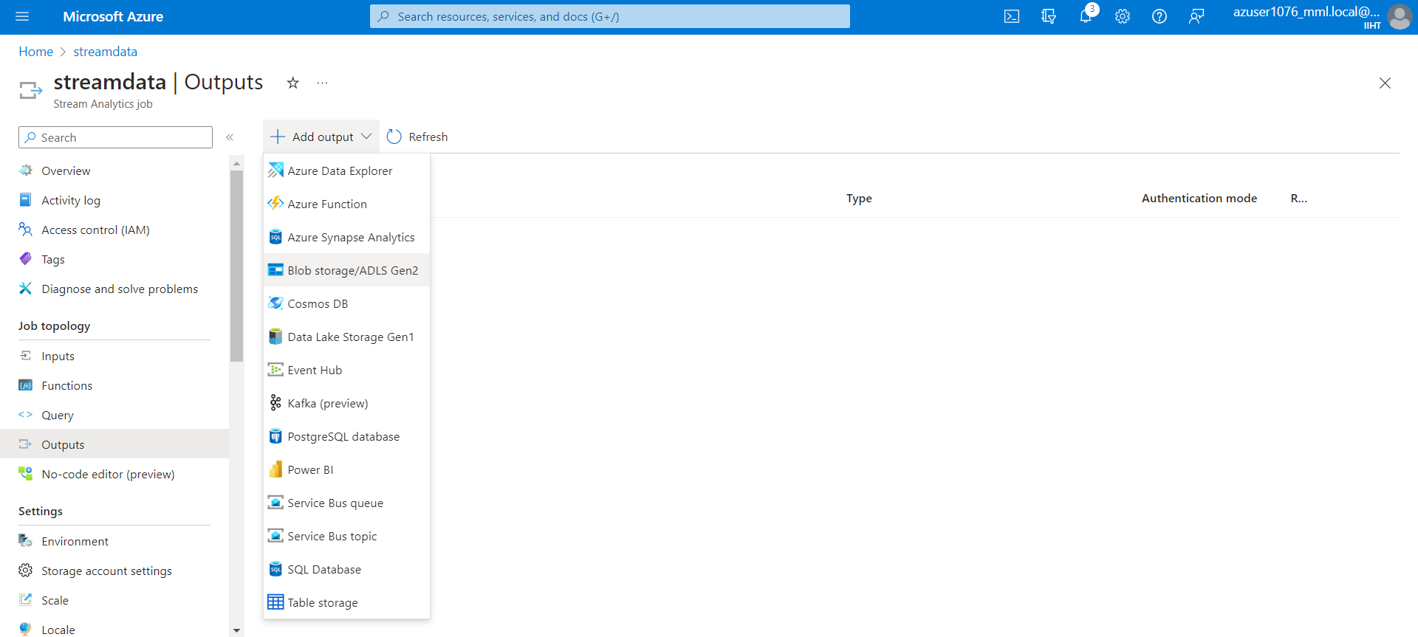
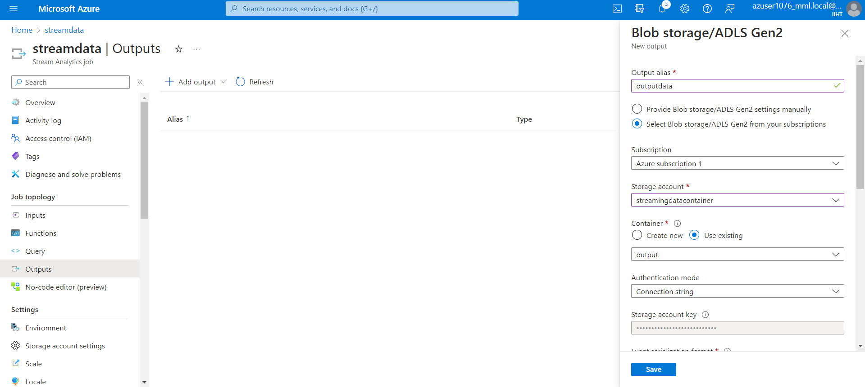
Output Service in Stream Analytics

Slide 22
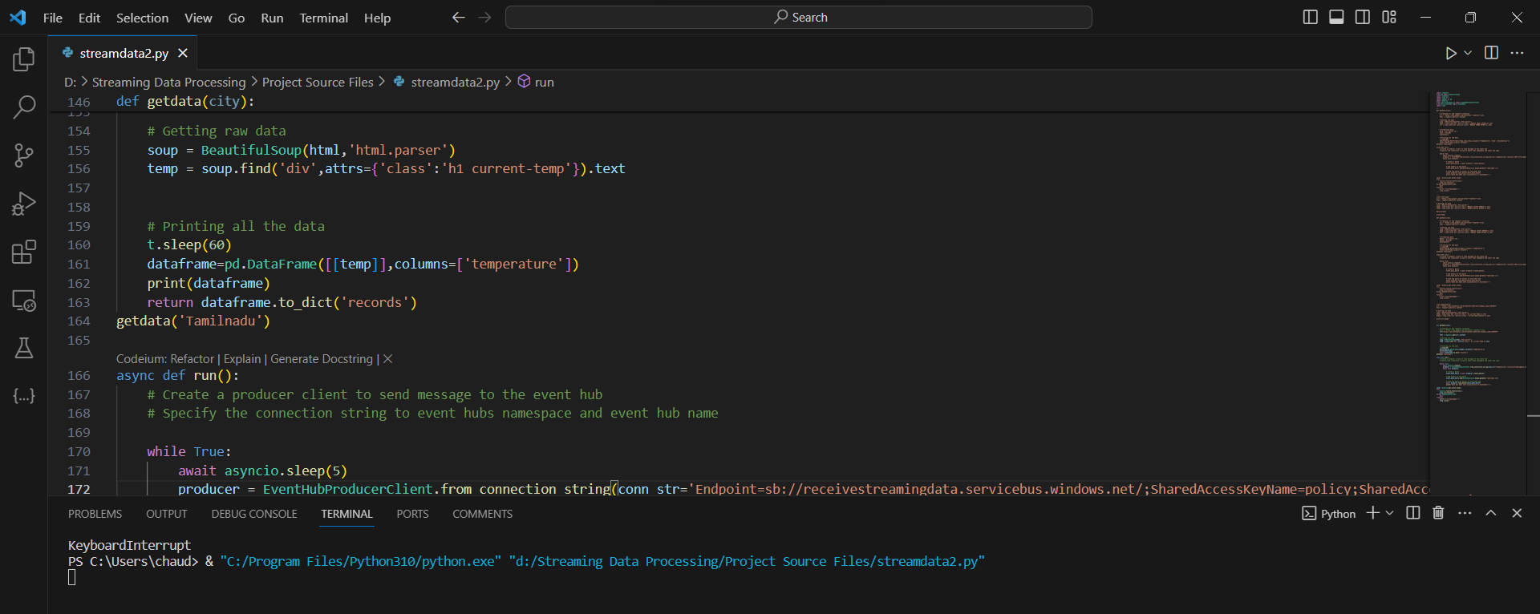
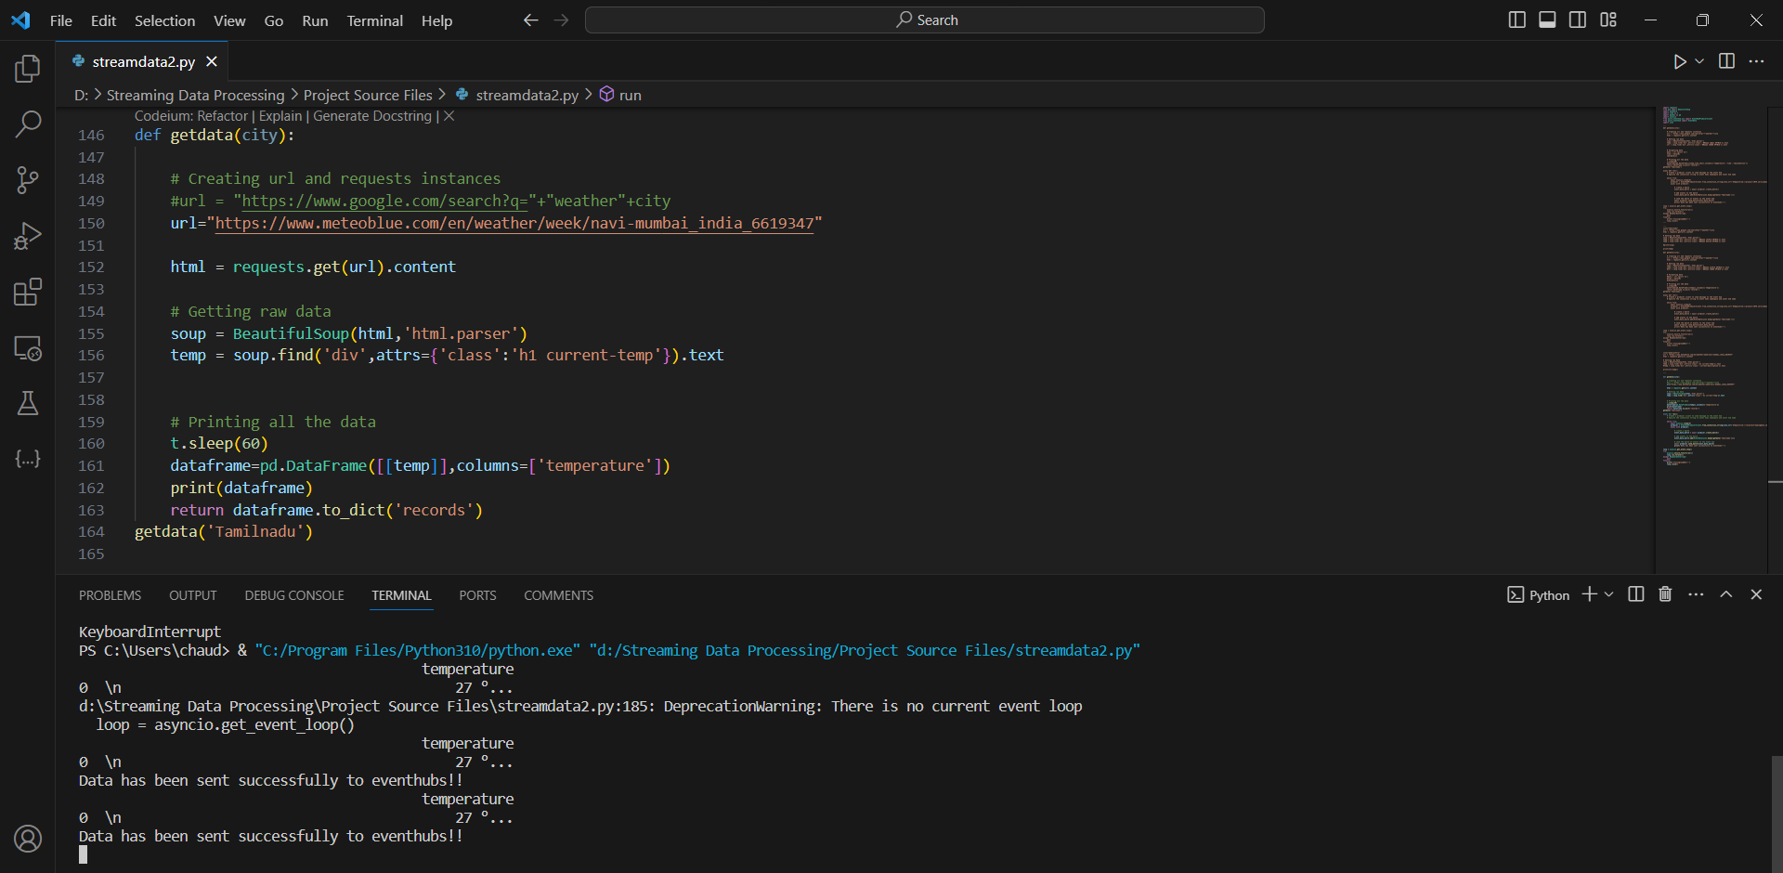
Running Python Application

Slide 23
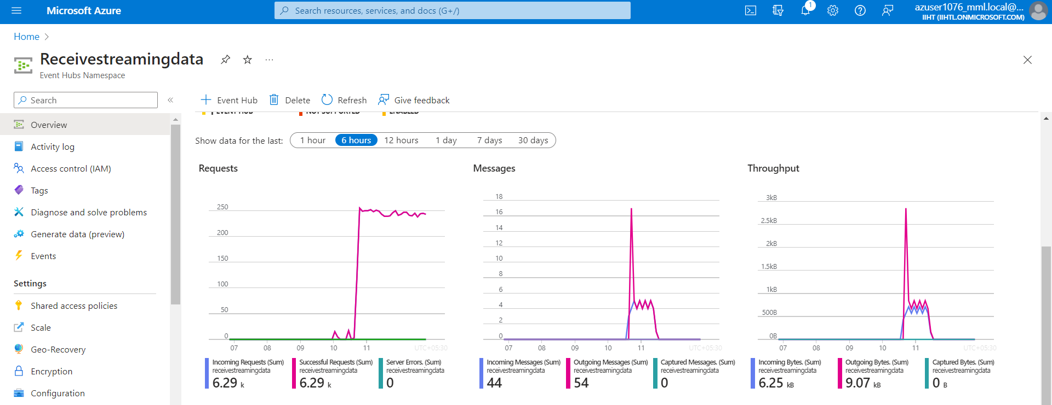
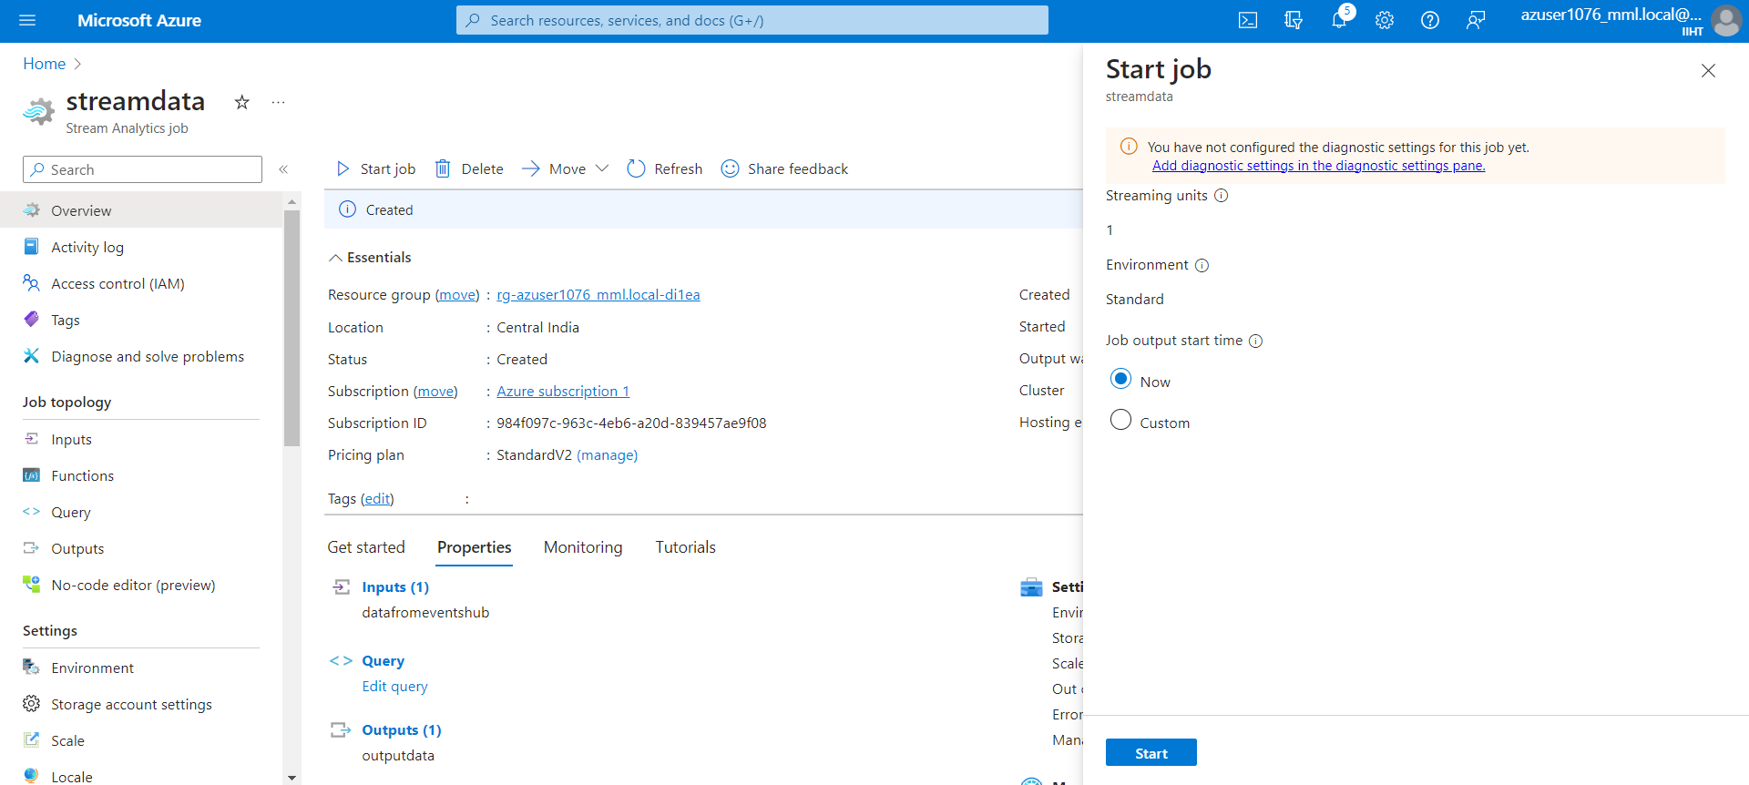
Starting and Running Stream Analytics Job
This is the Event hub Metric where data is getting received
The Azure Stream Analytics Job and start the job

Slide 24
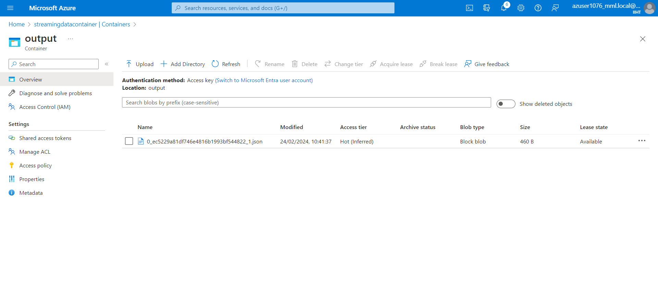
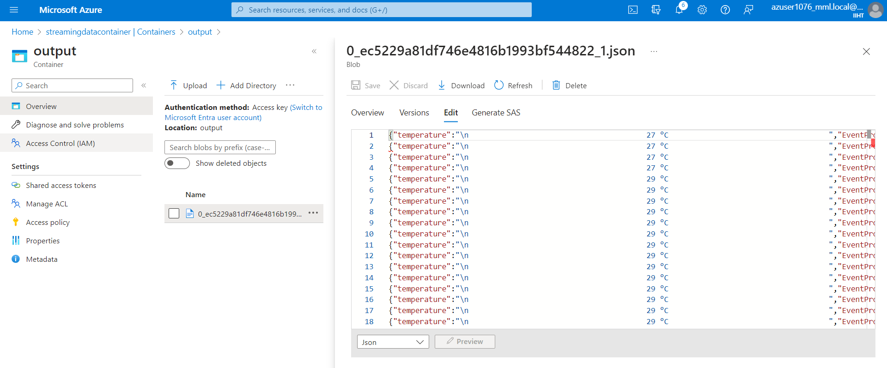
Azure Data Lake Storage
The output file is present in Container in JSON format

Slide 25
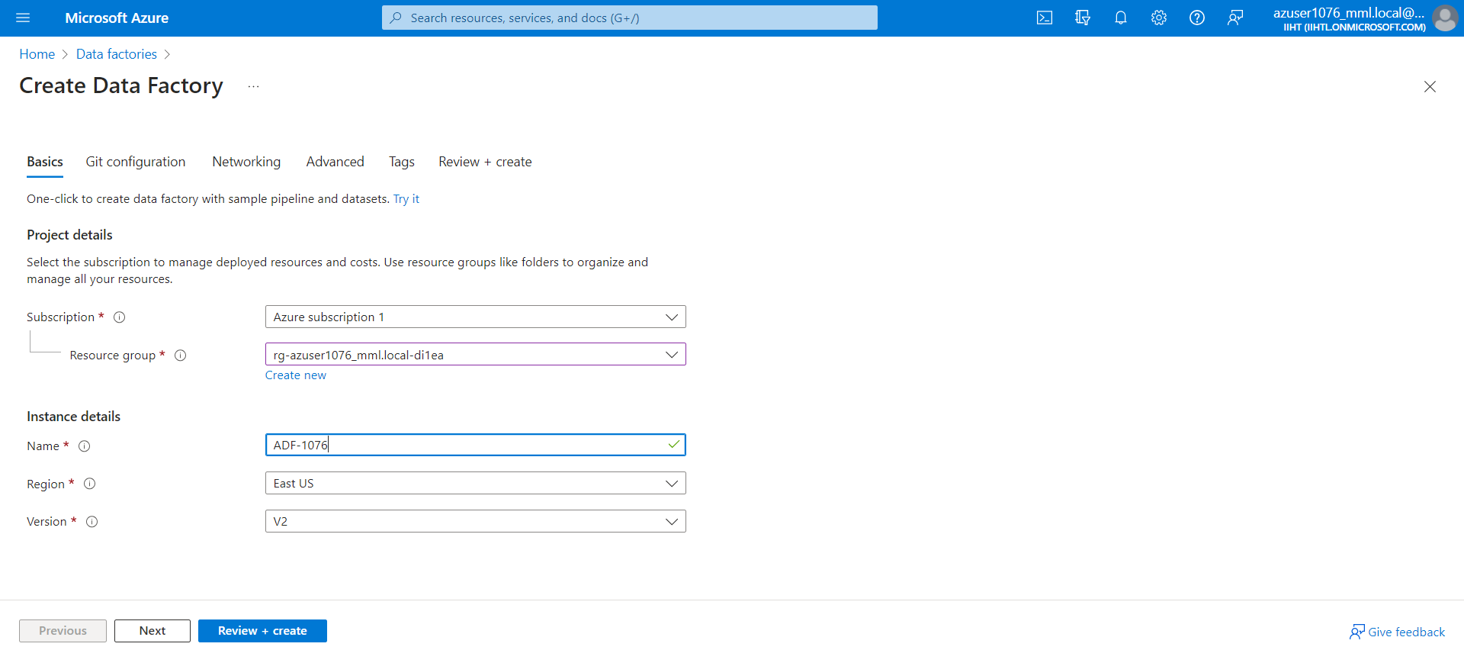
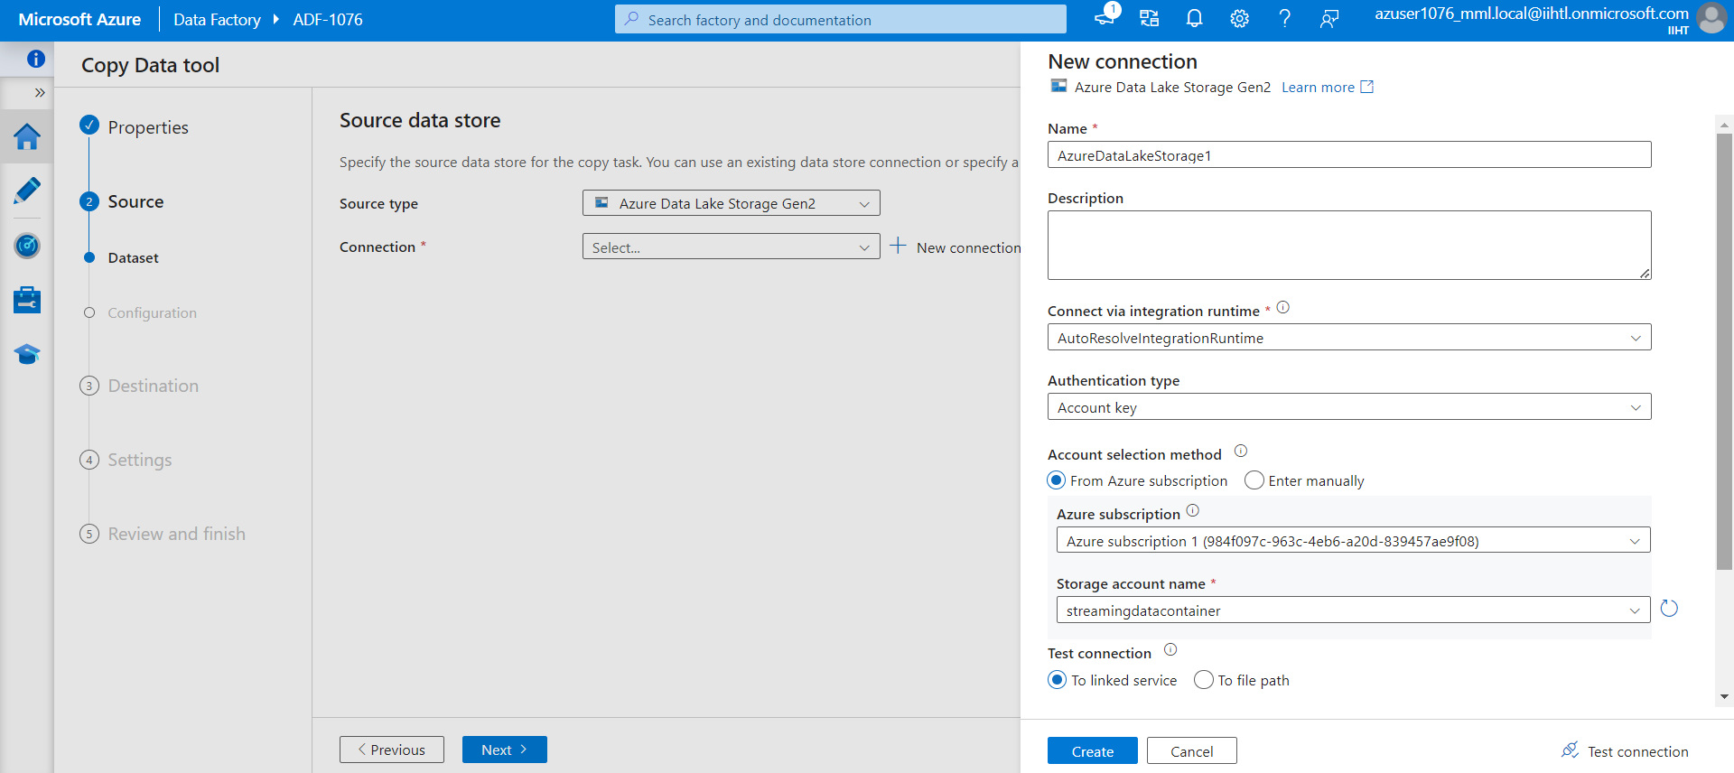
Azure Data Factory
Creating A Data Factory
Selecting the Source Data Storage

Slide 26
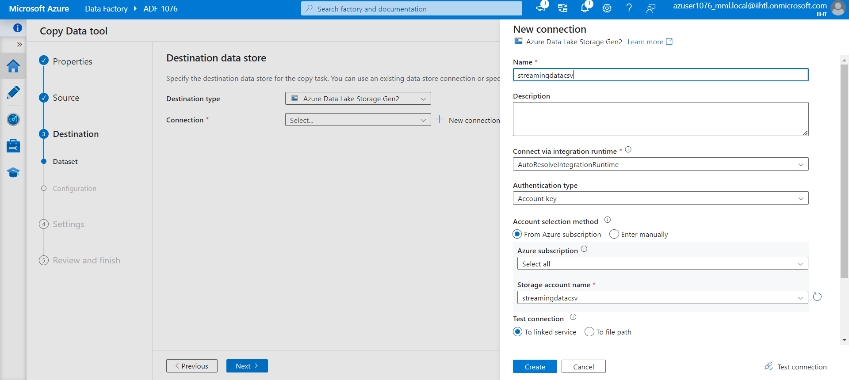
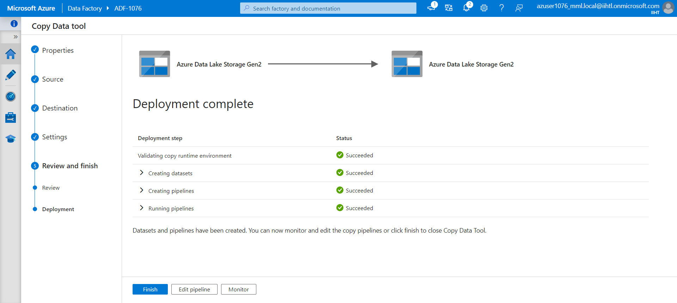
Selecting Destination Storage account
Creating Pipeline

Slide 27
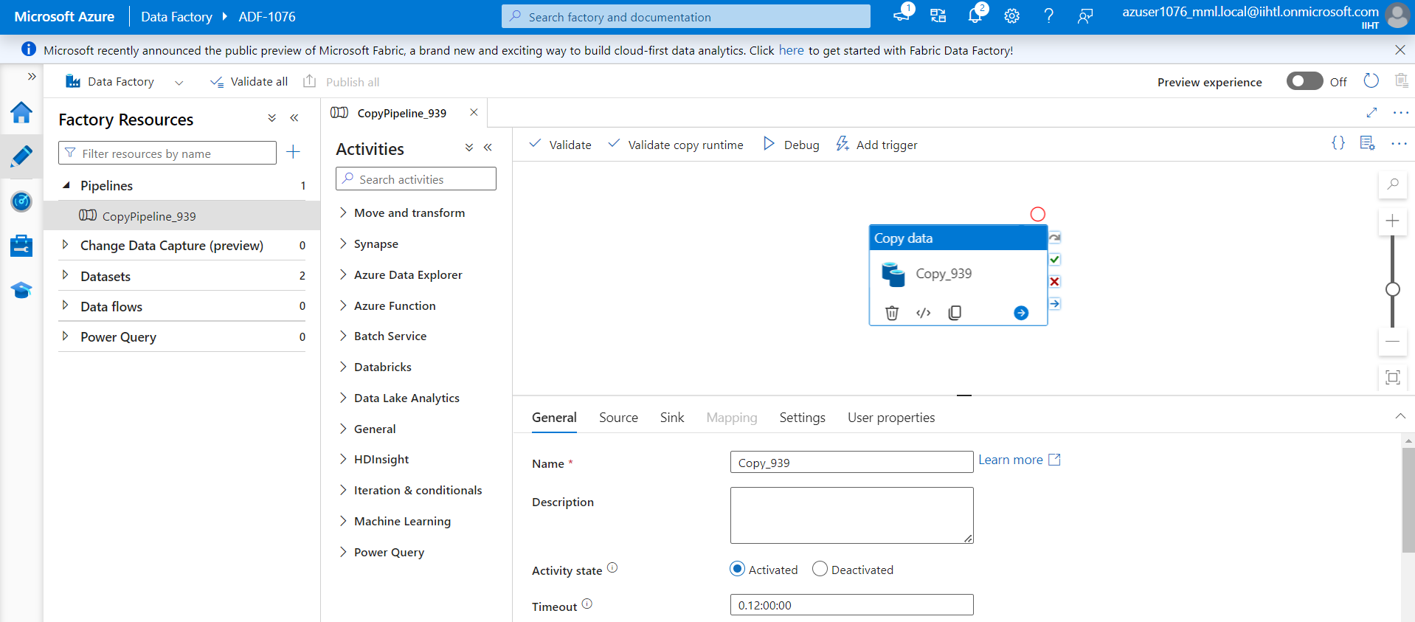
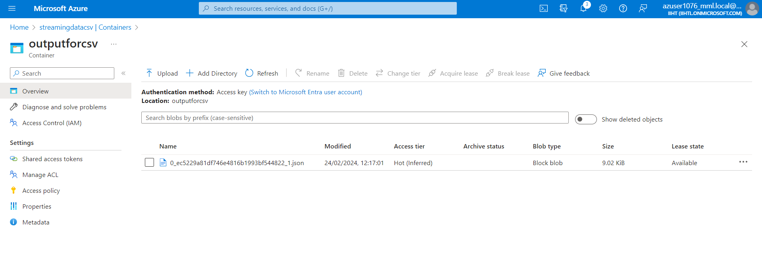
creating a pipeline to initiate the copy activity
Data is been updated in Sink dataset

Slide 28
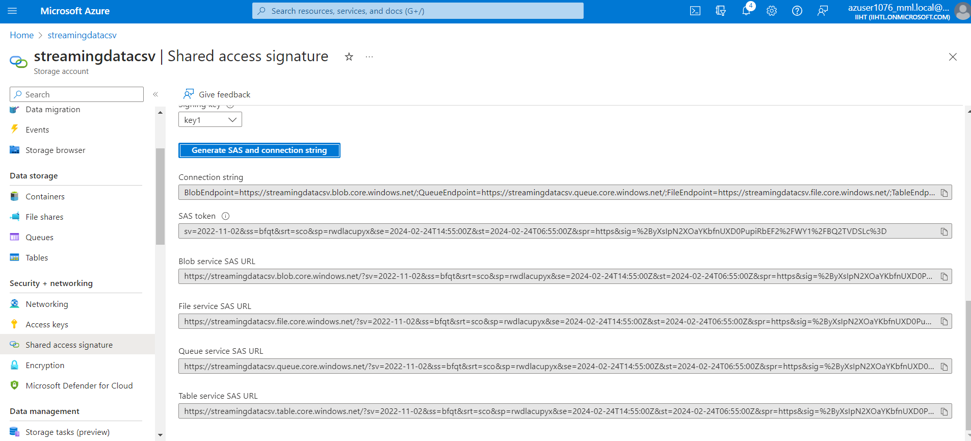
Generating SAS and Connection String

Slide 29
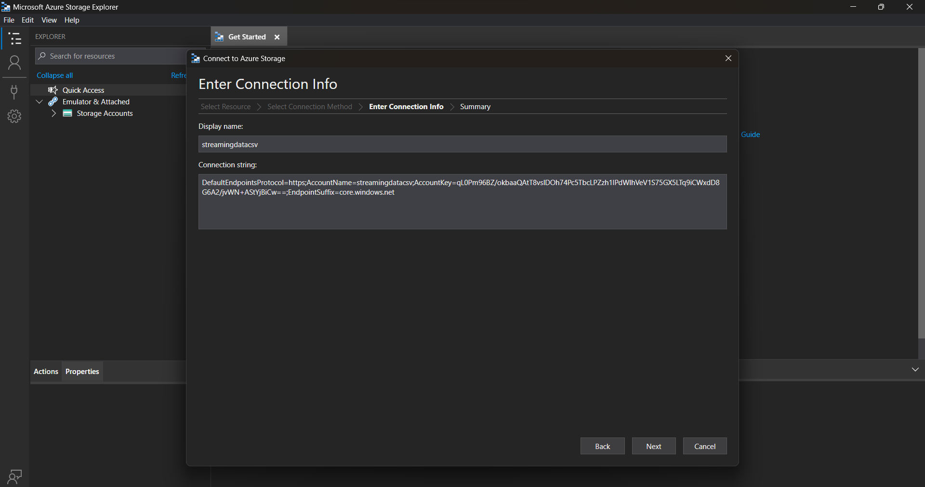
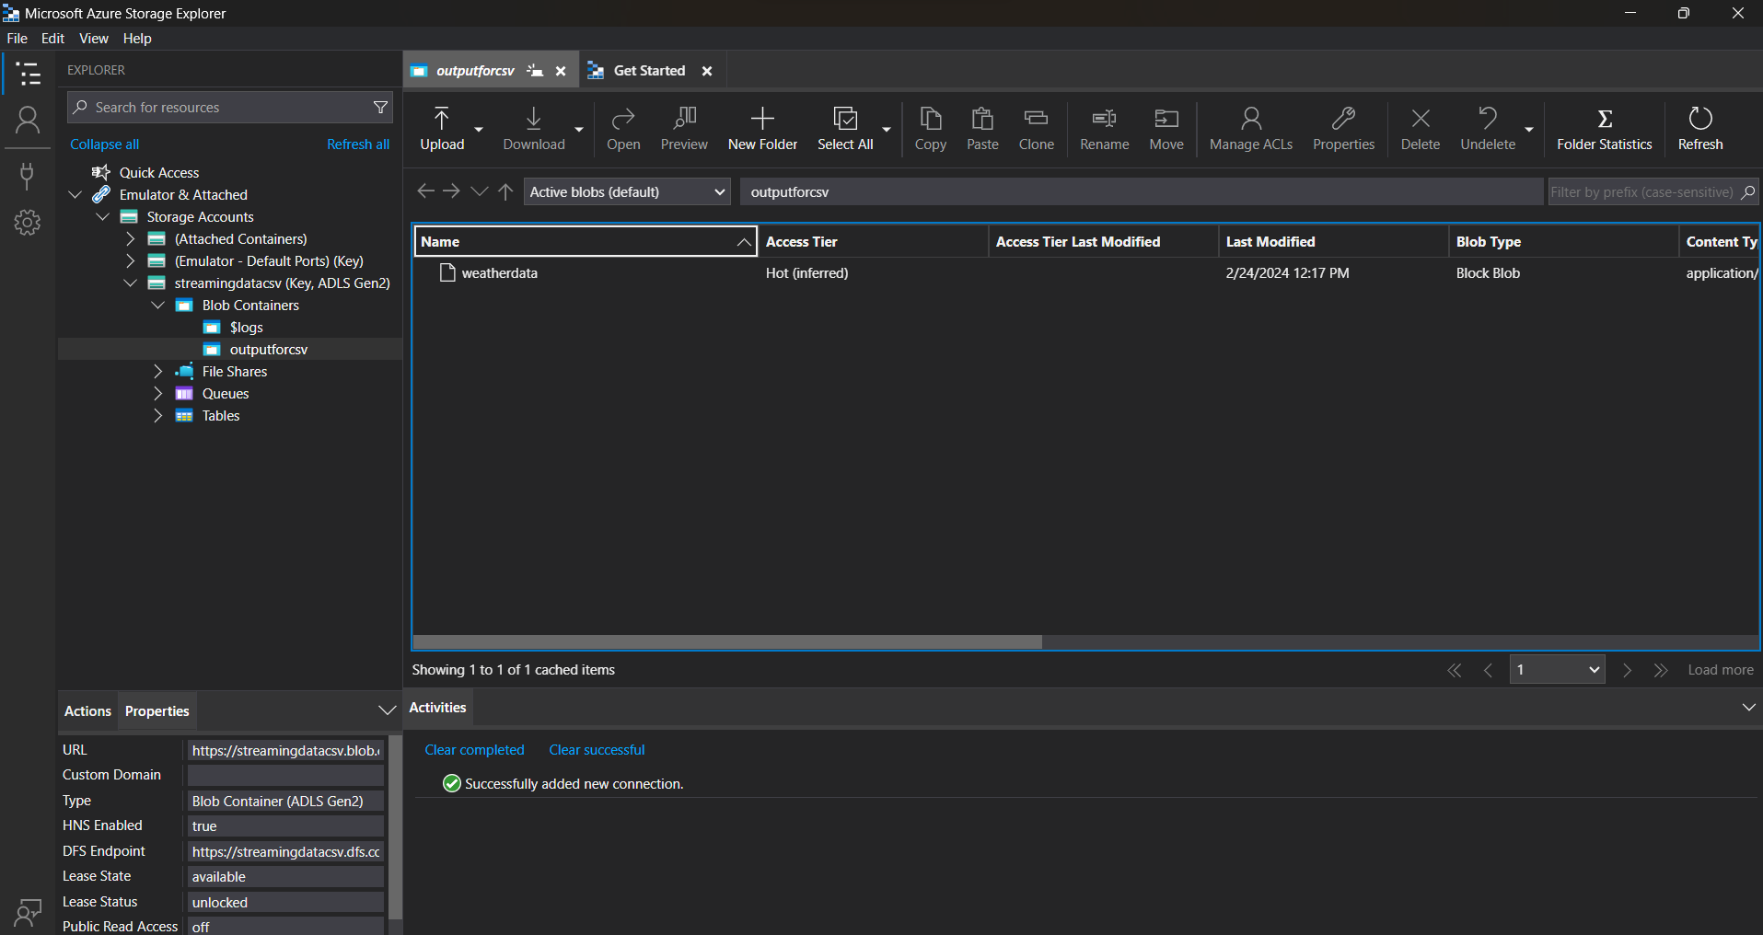
Establishing the connection with explorer
Connection was established successfully

Slide 30
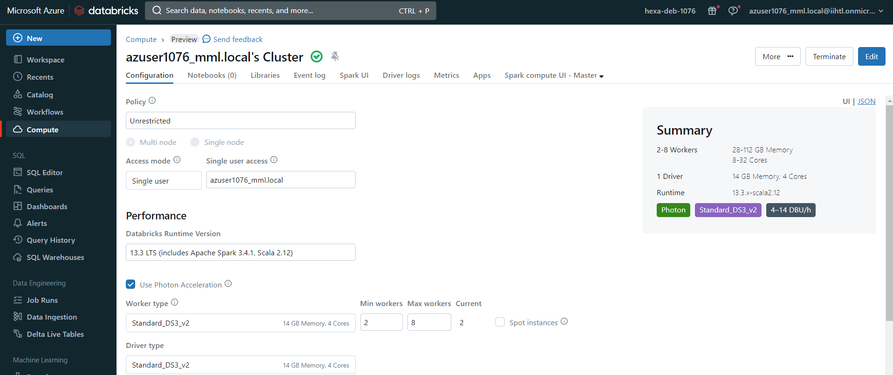
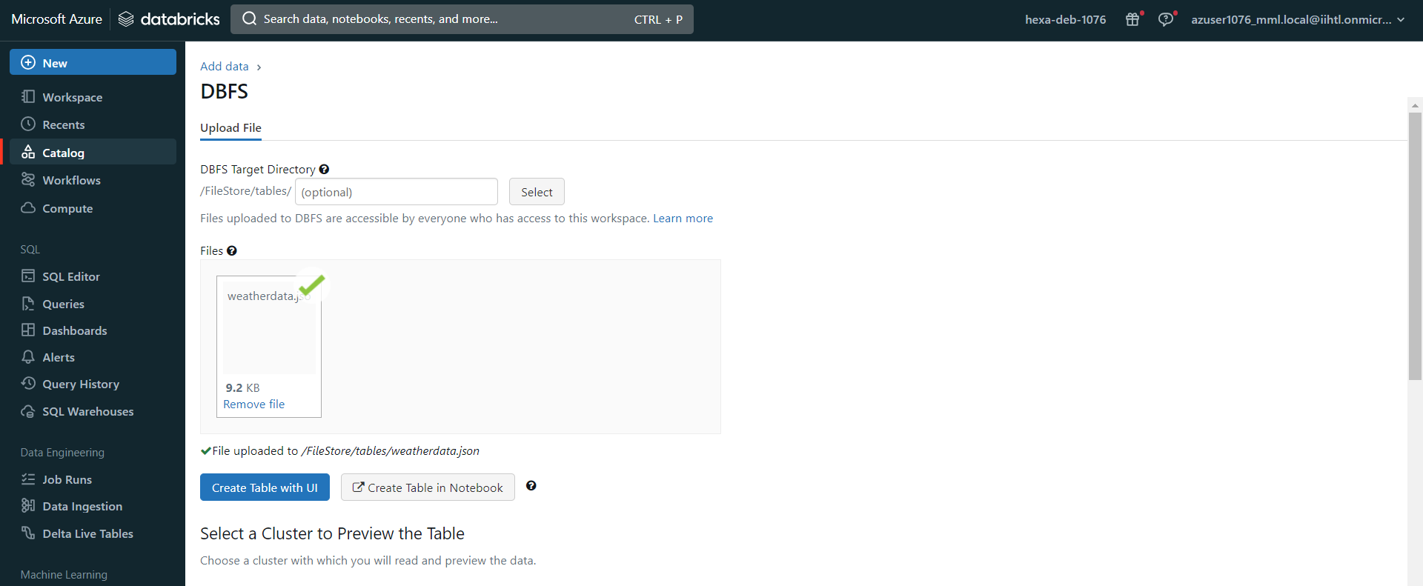
Azure Databricks
Creating Clusters
uploading the file by using create a new table option and select Create Table in Notebook

Slide 31
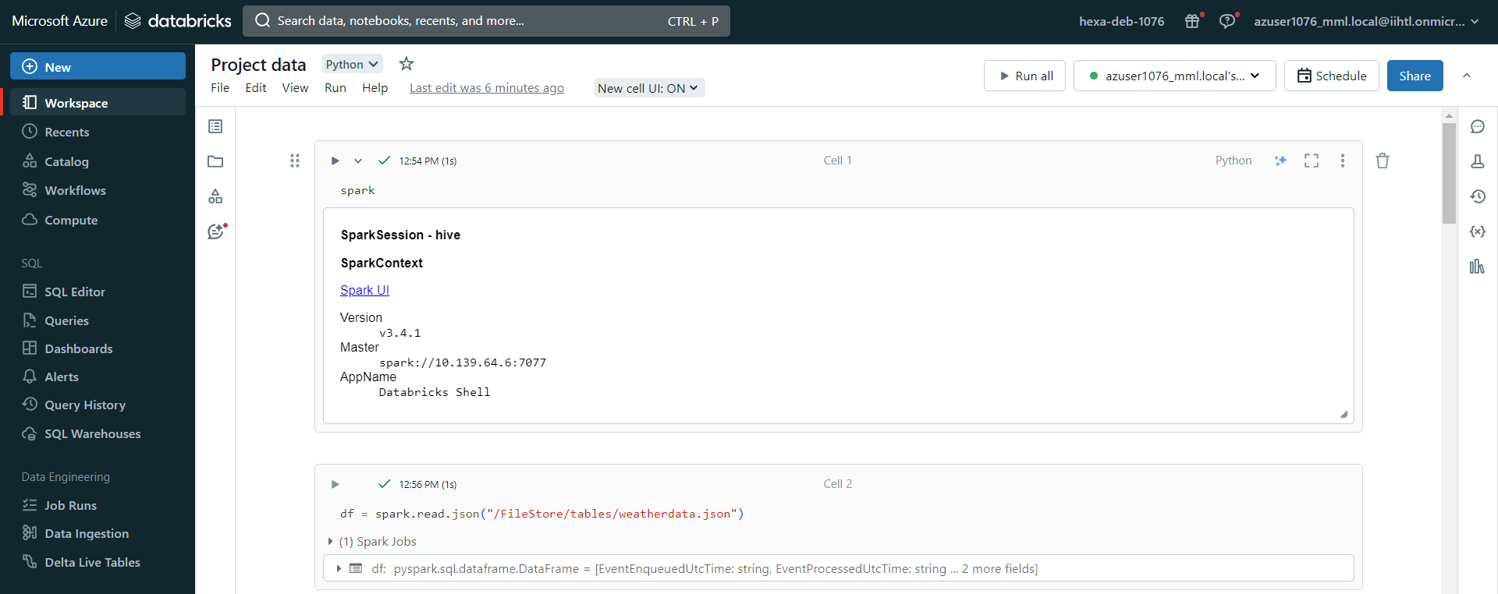
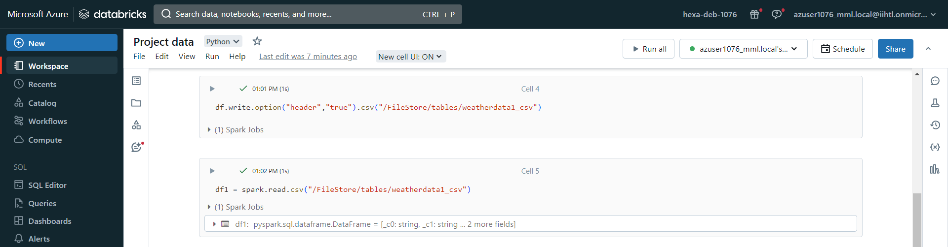
Analyzing the Uploaded Data

Slide 32
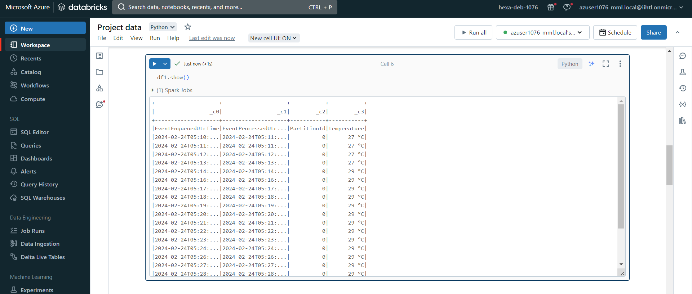
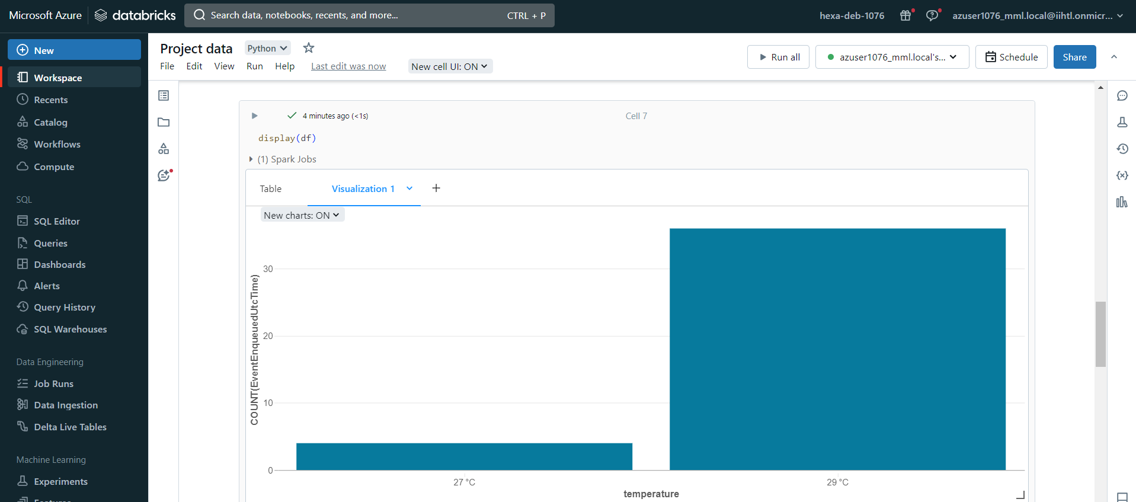
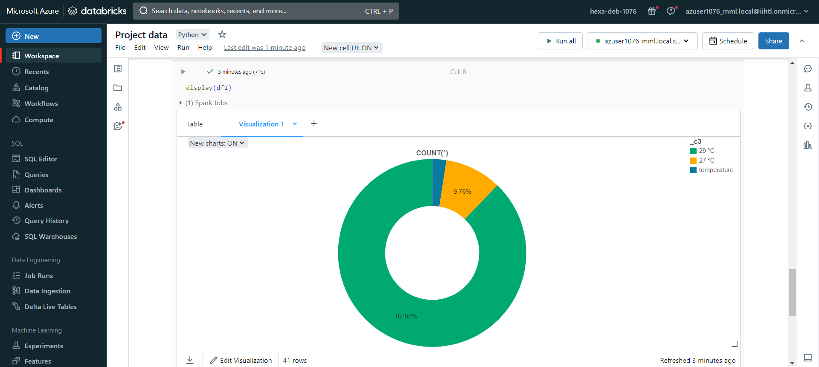

Slide 33
Conclusion
Setting up an end-to-end pipeline with Azure Data Factory for ingesting streaming data and Azure Databricks for real-time processing and analysis is a powerful approach for handling streaming data workflows. This setup allows you to efficiently ingest, process, and analyse data in real time, enabling you to derive valuable insights and make timely decisions. The flexibility and scalability of these Azure services enable you to adapt to changing data requirements and scale your pipeline as your data volume grows. Overall, this combination of Azure Data Factory and Azure Databricks provides a reliable and efficient solution for handling streaming data processing tasks.

